Slide 1
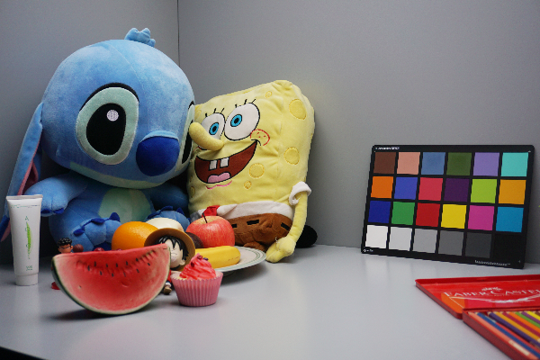
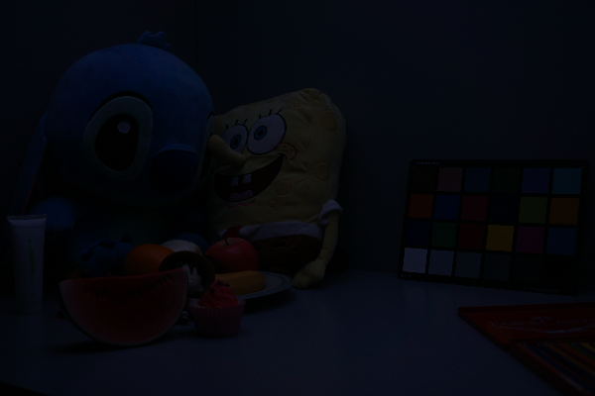
Convolutional Neural Network and Deep Learning
Low Light Image Enhancement

Slide 2
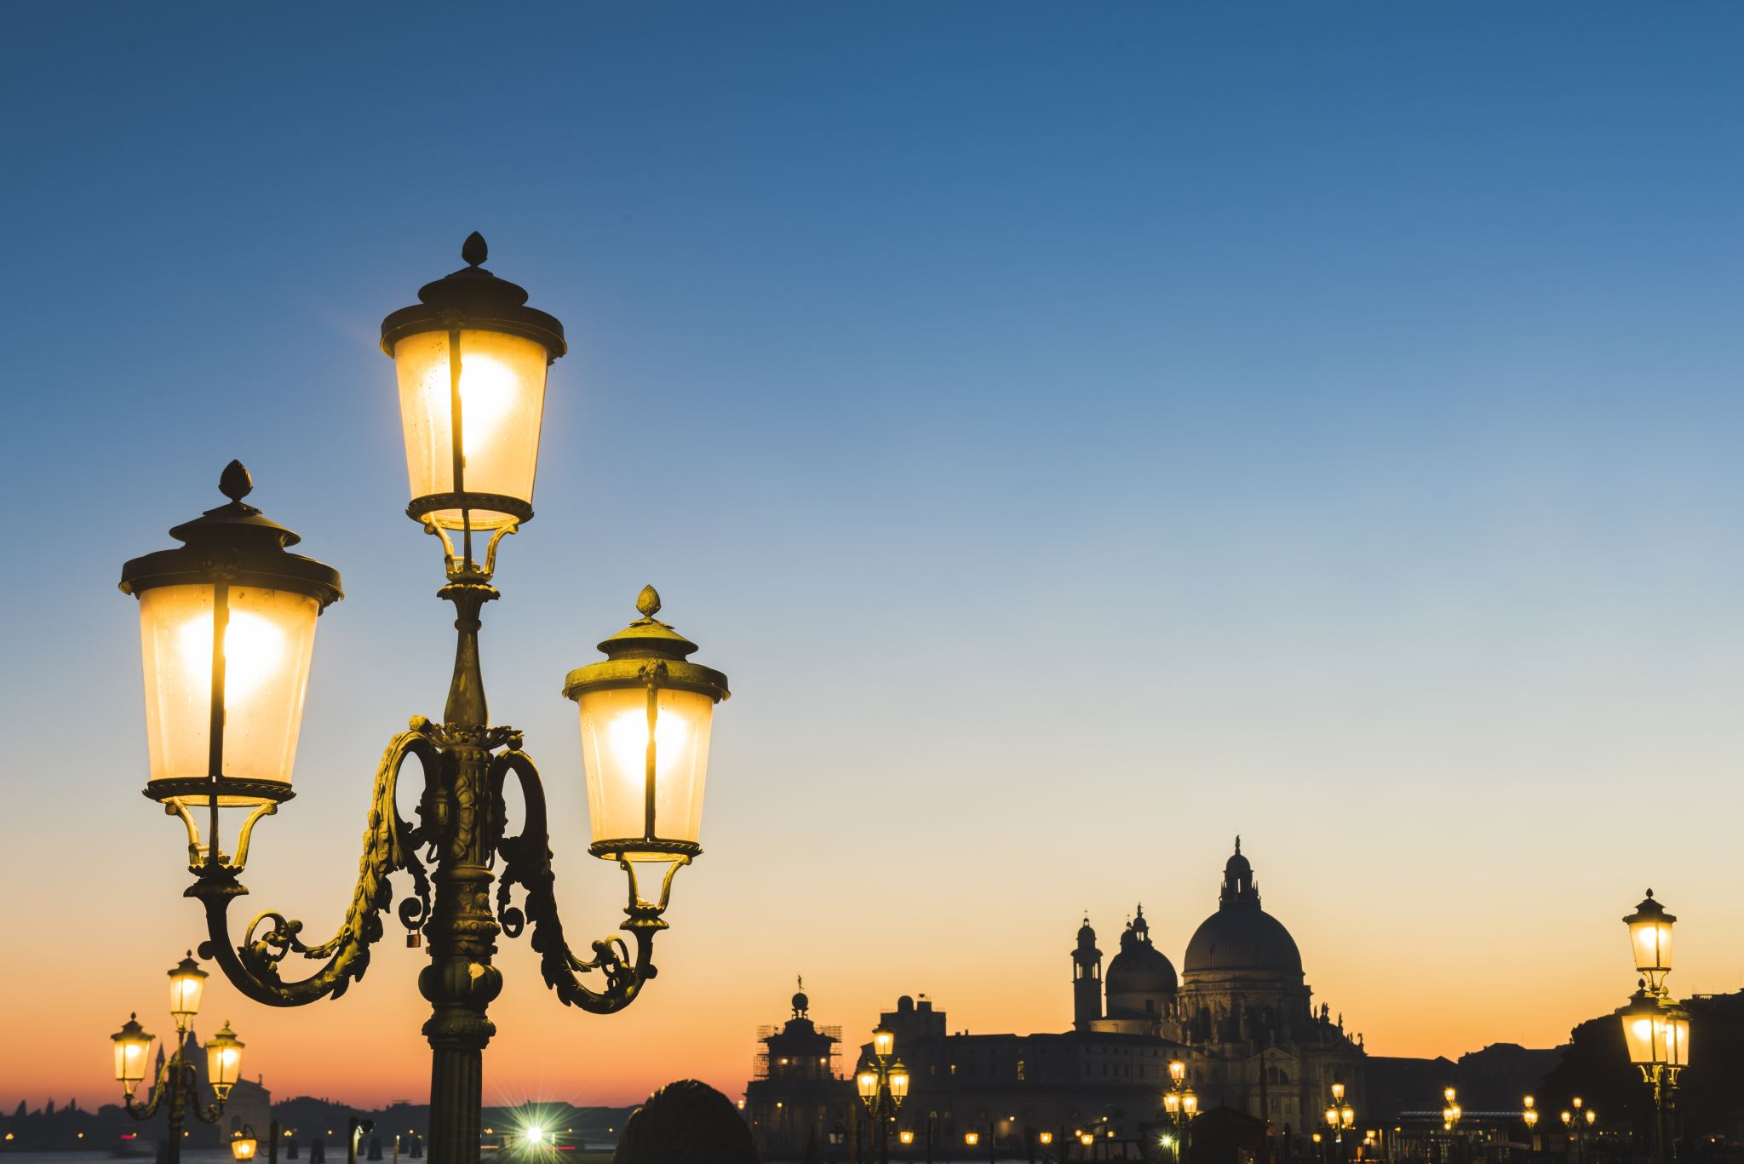
Introduction

Slide 3
Introduction
In the field of computer vision and image processing, the challenge of enhancing low-light images has been an age old obstacle. Dim images usually reduces the details. For overcoming this problem we have designed a CNN model for enhancing a low light image.

Slide 4

Low light image dataset(Kaggle)

Slide 5
Low light image dataset
LOL Dataset (kaggle.com)
Low light image dataset
The Low light dataset is composed of 500 low-light and normal-light image pairs and is divided into 485 training pairs and 15 testing pairs.

Slide 6
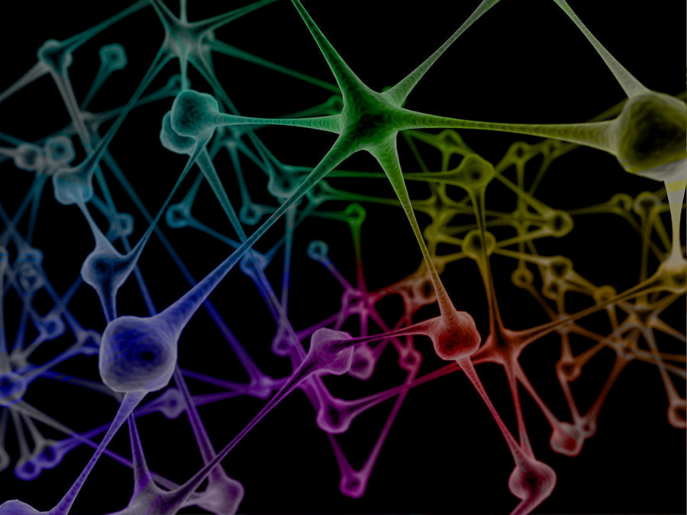
Methodology

Slide 7
Methodology
Here we are working with a CNN model with a training dataset. The dataset contains low light images and its corresponding enlightened images. We use this dataset to train a CNN model with multiple branches, after which we make the model to generate an enhanced image.

Slide 8
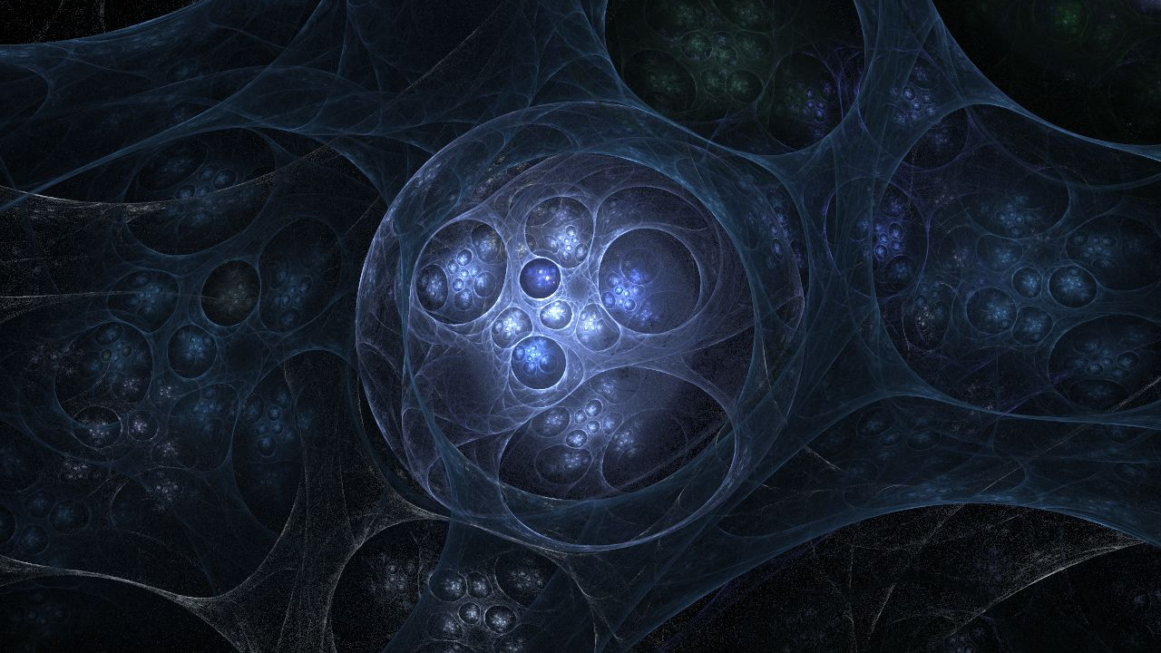
Implementation Details

Slide 9
Implementation Details
Data Loading and Exploration
Define paths for low light and high light image directories for both training and testing.
3) Data Splitting
Use train_test_split from scikit-learn to split the data into training and validation sets
(80 : 20).
2) Image Preprocessing
Load and preprocess the images using OpenCV, converting them from BGR to RGB.
Resize the images to a consistent size (e.g., 256x256) using cv2.resize.
Normalize the pixel values to the range [0, 1].

Slide 10
Implementation Details
4) Model Architecture
l Overview:
Input Layer:
Image input size: (256, 256, 3) for RGB images.
Convolutional Branches:
Multiple branches process input differently.
Branch 1 and Branch 3: 3 convolutional layers each with increasing filters and ReLU activation.
Branch 2: 3 convolutional layers with ReLU activation.
Merge Operation:
Branch outputs are merged using element-wise addition.
Output Branch:
Merged features go through a convolutional layer to produce a 3-channel enhanced image.

Slide 11
Implementation Details
5) Model Compilation and Training
Compile the model using an optimizer ('adam') and a suitable loss function ('mean_squared_error’).
Train the model using the training data with a validation split.
Monitor training progress using metrics like accuracy.
l Overview:
6) Evaluation
Evaluate the trained model on the test data using the evaluate method.l Overview:

Slide 12
Implementation Details
7) Performance Metrics
Define functions to calculate PSNR and SSIM scores using appropriate libraries (e.g., scikit-image).
Calculate individual scores for each test image and average scores Overview:
8) Testing with Real Samples
Overview:

Slide 13
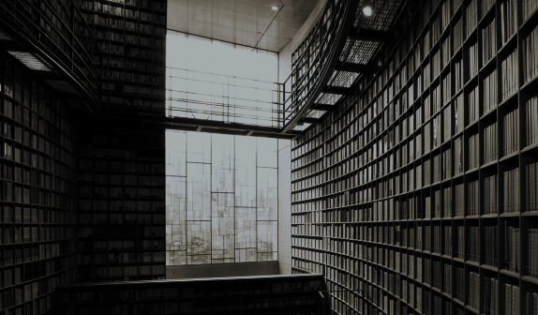
Base Paper Links

Slide 14
Base Paper Links
Based on image enhancement
Low-light Enhancement Using Retinex-Decomposition Convolutional Neural Networks | IEEE Conference Publication | IEEE Xplore
Subband Adaptive Enhancement Of Low Light Images Using Wavelet-Based Convolutional Neural Networks | IEEE Conference Publication | IEEE Xplore
Low-Light Image Enhancement for UAVs With Multi-Feature Fusion Deep Neural Networks | IEEE Journals & Magazine | IEEE Xplore
arxiv.org/pdf/2207.10564.pdf

Slide 15
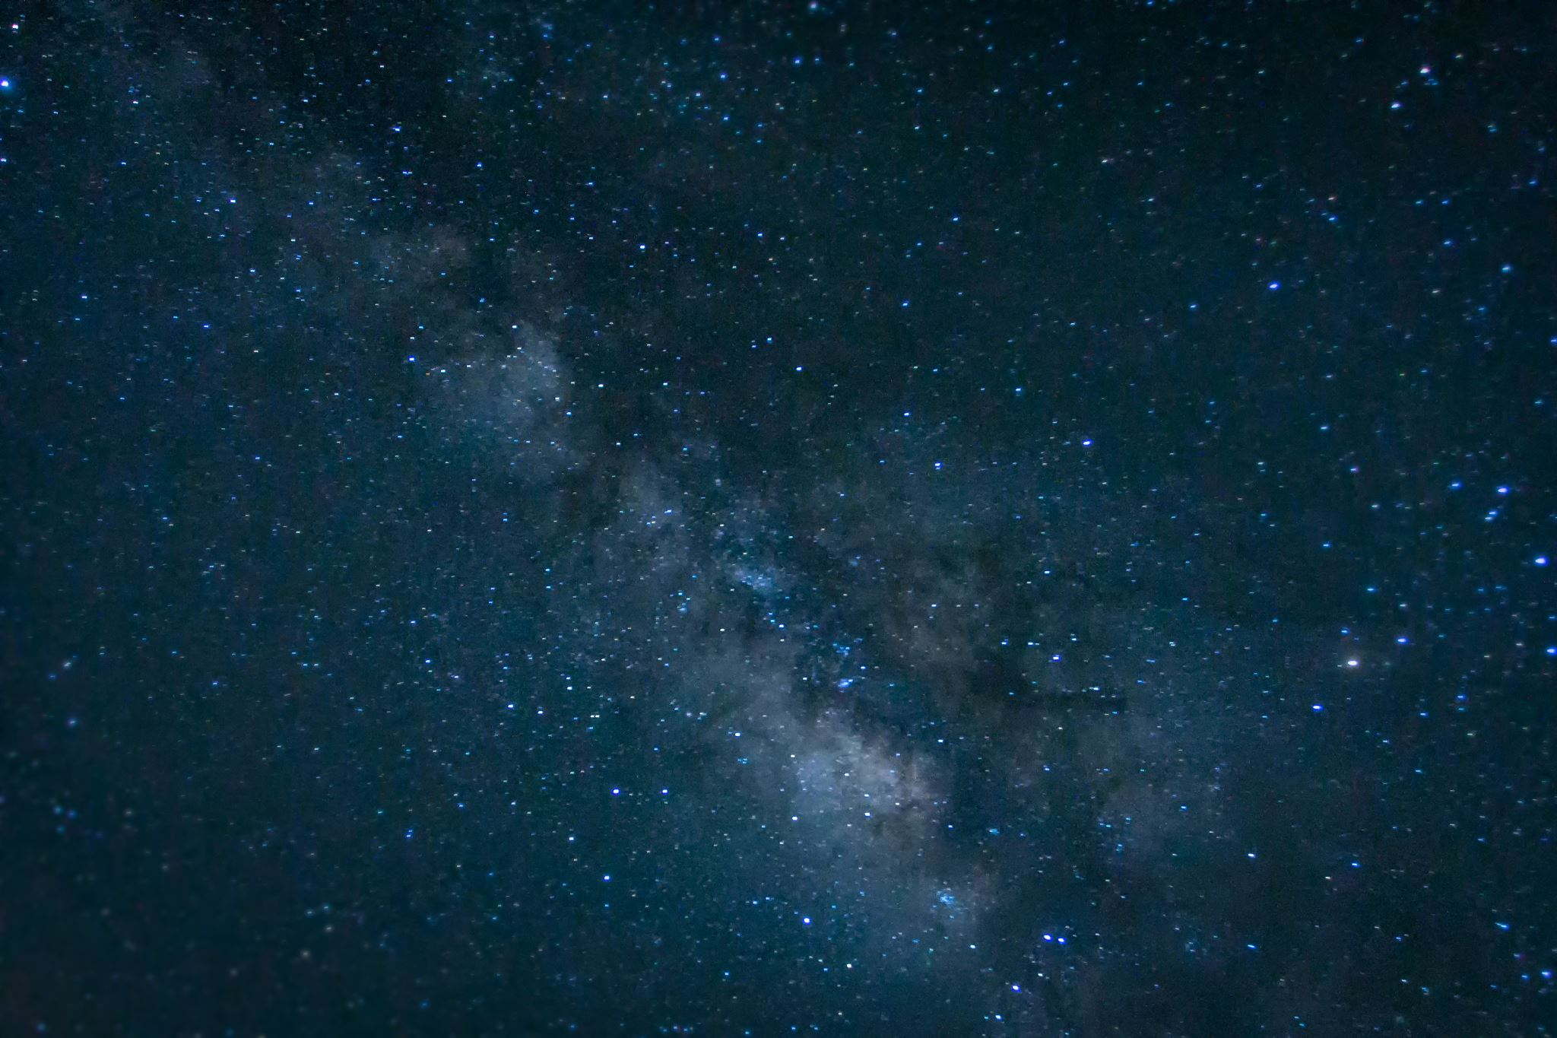
Reference Link
https://github.com/jinyeying/night-enhancement/blob/main/main.py
https://github.com/dawnlh/awesome-low-light-image-enhancement
https://www.geeksforgeeks.org/image-enhancement-techniques-using-opencv-python/

Slide 16

THANK YOU!
Submitted By:
Rishav Kumar Singh(2205762)
Sahil Kumar Singh(22051965)
Samridhi Pathak(22051968)
Shreya Katyayan(22051979)
Soumya Gupta(22051030)
Sourav Gupta(2205778)
Submitted to:
Dr. Rinku Datta Rakshit

